Slide 1

COS1512 – Online Class Session – 11 MAY 2026
COS1512 – INTRODUCTION TO PROGRAMMING II – Using C++
Academic Year: 2026
Date: 22 MAY 2026
Time: 17:00 PM to 19:00 PM

Slide 2
Topics
Chapter 5
Functions for All Subtasks

Slide 3
Contents
void Functions
Call-by-Reference Parameters
Using Procedural Abstraction
Testing and Debugging Functions
General Debugging Techniques

Slide 4
void Functions
void functions and value-returning functions have similar structures.
Because void functions do not have a data type such as int, double or bool, they are not used (called) in an expression. A call to a void function is a stand-alone statement. Thus, to call a void function, you use the function name together with the actual parameters (if any) in a stand-alone statement.
Remember you call a function in a main() function or another function.

Slide 5
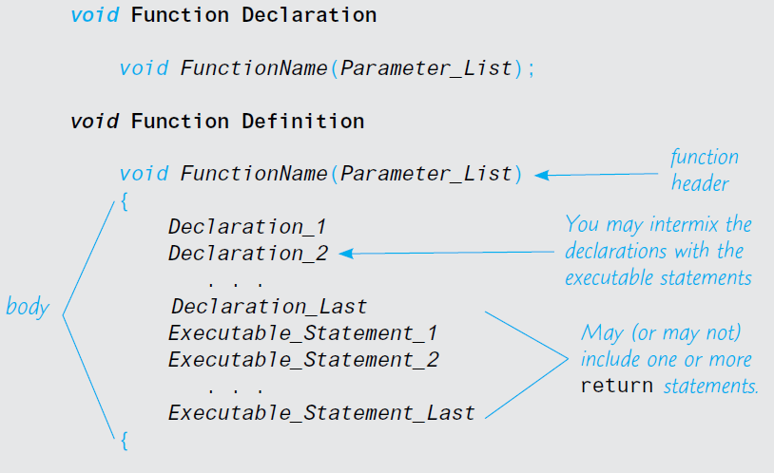
void Functions
Syntax for a void Function Definition

Slide 6
void Functions
Example of a void Function Definition
// void function definition
void showResults(double fDegrees, double cDegrees)
{
using namespace std;
cout.setf(ios::fixed);
cout.setf(ios::showpoint);
cout.precision(1);
cout << fDegrees
<< " degrees Fahrenheit is equivalent to\n"
<< cDegrees << " degrees Celsius.\n";
}

Slide 7
void Functions
Example of a void Function Definition
// void function definition
void showResults(double fDegrees, double cDegrees)
{
using namespace std;
cout.setf(ios::fixed);
cout.setf(ios::showpoint);
cout.precision(1);
cout << fDegrees
<< " degrees Fahrenheit is equivalent to\n"
<< cDegrees << " degrees Celsius.\n";
return;
}
In main() function
showResults(32.5, 0.3); // Function call

Slide 8
void Functions
return Statements in void Function Definition
// void function definition
The return statement simply ends the function call.
Every function that returns a value must end by executing a return statement.
However, a void function need not contain a return statement. If it does not contain a return statement, it will end after executing the code in the function body.

Slide 9
Call-by-Reference Parameters
When a function is called, memory for its formal parameters and variables declared in the body of the function (called local variables) is allocated in the function data area.
Recall that in the case of a value parameter, the value of the actual parameter is copied into the memory cell of its corresponding formal parameter.
In the case of a reference parameter, the address of the actual parameter passes to the formal parameter. That is, the content of the formal parameter is an address.

Slide 10
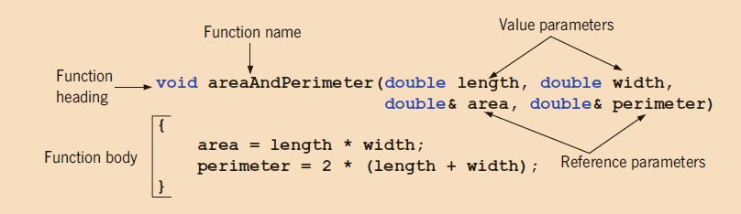
Call-by-Reference Parameters
void areaAndPerimeter(double length, double width, double& area, double& perimeter)
{
area = length * width;
perimeter = 2 * (length + width);
}

Slide 11
Call-by-Reference Parameters
Example:
// function declarations or prototypes
void funOne(int a, int& b, char v);
void funTwo(int& x, int y, char& w);
// function definition
void funOne(int a, int& b, char v)
{
int one; one = a; a++;
b = b * 2;
v = 'B’;
cout << "Inside funOne: a = " << a
<< ", b = " << b << ", v = " << v
<< ", and one = " << one << endl;
}
// function definition
void funTwo(int& x, int y, char& w)
{
x++; y = y * 2; w = 'G';
cout << "Inside funTwo: x = " << x
<< ", y = " << y << ", and w = " << w
<< endl;
}

Slide 12
Call-by-Reference Parameters
int main()
{
int num1, num2; char ch;
num1 = 10;
num2 = 15;
ch = ‘A’;
cout << "Inside main: num1 = " << num1
<< ", num2 = " << num2 << ", and ch = "
<< ch << endl;
funOne(num1, num2, ch); // call funOne
cout << "After funOne: num1 = " << num1
<< ", num2 = " << num2 << ", and ch = "
<< ch << endl;
funTwo(num2, 25, ch); // call funTwo
cout << "After funTwo: num1 = " << num1
<< ", num2 = " << num2 << ", and ch = "
<< ch << endl;
return 0;
}
Inside main: num1 = 10, num2 = 15, and ch = A
Inside funOne: a = 11, b = 30, v = B, and one = 10
After funOne: num1 = 10, num2 = 30, and ch = A
Inside funTwo: x = 31, y = 50, and w = G
After funTwo: num1 = 10, num2 = 31, and ch = G

Slide 13
Using Procedural Abstraction
Using Procedural Abstraction
Functions Calling Functions
A function body may contain a call to another function. The situation for these sorts of function calls is exactly the same as it would be if the function call had occurred in the main function of the program.

Slide 14
Programmer Defined Functions
Programmer defined functions – Example:
// determine the largest number from a
// between two numbers
// Function prototype
double larger(double x, double y);
// determine the largest number from a
// between two numbers
// Function prototype
double compareThree(double x, double y, double z);
// Function implementation
double larger(double x, double y)
{
if (x >= y)
return x;
else
return y;
}
// Function implementation
double compareThree(double x, double y, double z)
{
// Call function larger inside
// function compareThree to perform
// the comparison between y and z
return larger(x, larger(y, z));
}

Slide 15
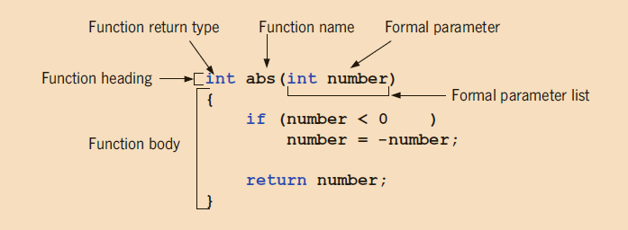
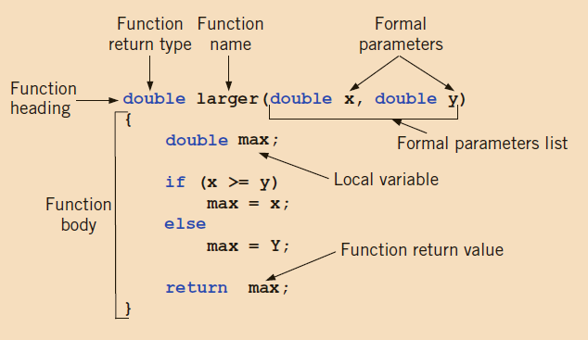
Programmer Defined Functions
Programmer defined functions –Various parts of the function abs
Various parts of the function larger

